Slide 1
Checking understanding of perimeter and area
Perimeter and area

Slide 2
how to use Oak lessons

Slide 3
I can explain the properties of various polygons.

Slide 4
A polygon is a flat (2D), closed figure made up of straight line segments.
Quadrilaterals are polygons that have 4 sides.
A regular polygon has sides that are all equal and interior (inside) angles that are all equal.
An irregular polygon has sides that are not equal or interior (inside) angles that are not equal.
Two lines are parallel if they are straight lines that are always the same (non-zero) distance apart.

Slide 5

Checking understanding of perimeter and area
Defining a shape
Grouping shapes by properties
Finding missing lengths with shape properties
Missing lengths in composite rectilinear shapes

Slide 6
Defining a shape
There are an infinite number of shapes in the world.
Some shapes can be grouped into ‘families’ because they share the same characteristics.
An example of this is the family of quadrilaterals. All polygons with four sides are quadrilaterals but they can look very different!

Slide 7
Defining a shape
These are just a few examples of shapes that belong in the family of quadrilaterals.

Slide 8
Defining a shape
They fit in broader categories too, like the family of polygons.

Slide 9


Defining a shape
What shape might Sofia be thinking of?
My shape has four sides.

Slide 10
Defining a shape
What shape am I thinking of?
‘My shape has four sides.’
Could be any quadrilateral e.g.

Slide 11
Defining a shape
What shape might Sofia be thinking of?
My shape has four interior angles which are all right angles.

Slide 12
Defining a shape
What shape am I thinking of?
‘My shape has four interior angles which are all right angles.’
Could be either a square or a rectangle e.g.

Slide 13
Defining a shape
What shape might Sofia be thinking of?
My shape has four sides which are the same length.

Slide 14
Defining a shape
What shape am I thinking of?
‘My shape has four sides which are the same length.’
The shape must be a square or a rhombus.

Slide 15
Defining a shape
1) Pick one of the shapes and describe it to your partner.
How many clues did it take?
Which shape required the most clues?

Slide 16
Defining a shape
1) Pick one of the shapes and describe it to your partner.
How many clues did it take?
Which shape required the most clues?

Slide 17
Defining a shape
1) There are many possibilities. Here are some examples:
My shape is not a polygon.
My shape has six sides.
My shape has four sides. There are two pairs of parallel, equal sides. The interior angles are not right angles.

Slide 18
Checking understanding of perimeter and area
Defining a shape
Grouping shapes by properties
Finding missing lengths with shape properties
Missing lengths in composite rectilinear shapes

Slide 19
Grouping shapes by properties
Mathematicians group shapes based on properties such as:
how many sides they have
whether they are polygons
whether they are regular

Slide 20
Grouping shapes by properties
All triangles belong to the family of polygons.
An equilateral triangle belongs to the family of regular polygons.

Slide 21
Grouping shapes by properties
All rectangles belong to the family of polygons.
A square belongs to the family of regular polygons.
In fact, a square can be thought of as a ‘regular rectangle’.

Slide 22

Grouping shapes by properties
A pentagon has to be regular.
A pentagon has five sides but those sides do not have to be the same length.

Slide 23
Grouping shapes by properties
A kite is a regular quadrilateral.
A kite has two pairs of sides of the same length.

Slide 24

Grouping shapes by properties
Regular
1) a) Put each polygon in the correct place.
Square
Trapezium
(Irregular) Octagon
Kite
Equilateral triangle
Rhombus
b) Why are some of the spaces empty?
Quadrilateral
Irregular

Slide 25
Grouping shapes by properties
Regular
1) a) Put each polygon in the correct place.
Square
Trapezium
(Irregular) Octagon
Kite
Equilateral triangle
Rhombus
b) Why are some of the spaces empty?
Quadrilateral
Irregular

Slide 26
Grouping shapes by properties
Regular
1) a) Put each polygon in the correct place.
Square
Trapezium
(Irregular) Octagon
Kite
Equilateral triangle
Rhombus
Quadrilateral
Equilateral triangle
Square
Rhombus
Irregular
Kite
Trapezium
(Irregular) octagon

Slide 27
Grouping shapes by properties
Regular
1) b) Why are some of the spaces empty?
Some of the spaces are empty because a shape cannot be regular and irregular at the same time.
Quadrilaterals must be either regular or irregular and so cannot be neither.
Quadrilateral
Equilateral triangle
Square
Rhombus
Irregular
Kite
Trapezium
(Irregular) octagon

Slide 28
Checking understanding of perimeter and area
Defining a shape
Grouping shapes by properties
Finding missing lengths with shape properties
Missing lengths in composite rectilinear shapes

Slide 29

Finding missing lengths with shape properties
For a shape to be regular, all of its sides must be the same length and all of its interior angles must be the same size.
Showing the measurements for every side can produce a cluttered diagram:
2 cm
2 cm
2 cm
2 cm
2 cm
2 cm
2 cm
2 cm
2 cm
2 cm
2 cm
2 cm
2 cm

Slide 30
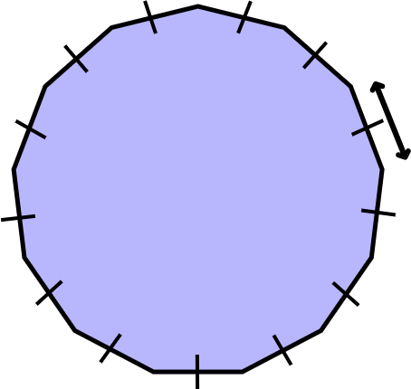
Finding missing lengths with shape properties
To overcome this, notation exists to show which lines are the same length.
Lines that are marked the same, have the same length.
2 cm
2 cm
2 cm
2 cm
2 cm
2 cm
2 cm
2 cm
2 cm
2 cm
2 cm
2 cm
2 cm
2 cm

Slide 31
Finding missing lengths with shape properties
Each subsequent set of lines of the same length are marked in a similar way.
b
x
x
x
b
b

Slide 32
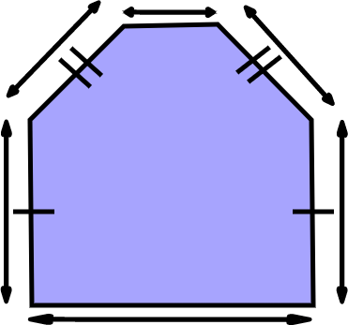
Finding missing lengths with shape properties
Fill in the missing lengths.
The length marked w is cm long.
The length marked k is cm long.
2 cm
3 cm
3
4.5 cm
4.5
7 cm

Slide 33
Finding missing lengths with shape properties
Sometimes the lines to indicate the same length are not needed because we can use the properties of the shape.
For example, in a rectangle, we know that the pairs of sides are the same length.

Slide 34
Finding missing lengths with shape properties
If one side of a square is 4 cm long, then all the sides are 4 cm long.
A square is a regular shape.

Slide 35
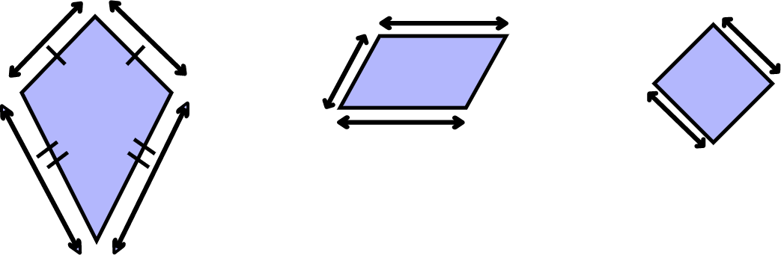

Finding missing lengths with shape properties
1) State the missing length for each shape.
a) b) c)
11
10
8
This is a parallelogram.
This is a 3 unit square.
17

Slide 36
Finding missing lengths with shape properties
1) State the missing length for each shape.
a) b) c)
11
10
8
This is a parallelogram.
This is a 3 unit square.
17
d = 17 e = 10 f = 11 g = 3 h = 3

Slide 37
Checking understanding of perimeter and area
Defining a shape
Grouping shapes by properties
Finding missing lengths with shape properties
Missing lengths in composite rectilinear shapes

Slide 38
Missing lengths in composite rectilinear shapes
Composite rectilinear shapes are shapes made from two or more rectangles.
We can use our knowledge of the properties of rectangles to reason about missing side lengths.

Slide 39

Missing lengths in composite rectilinear shapes
For example, we can work out the length of the side marked x in this shape.
The missing length must be 8 cm because 10 = 2 + 8
x cm
10 cm
2 cm

Slide 40

Missing lengths in composite rectilinear shapes
What is the length of the side marked y ?
2 cm
2 cm
5 cm
y cm
7 cm
9 cm
7 cm

Slide 41
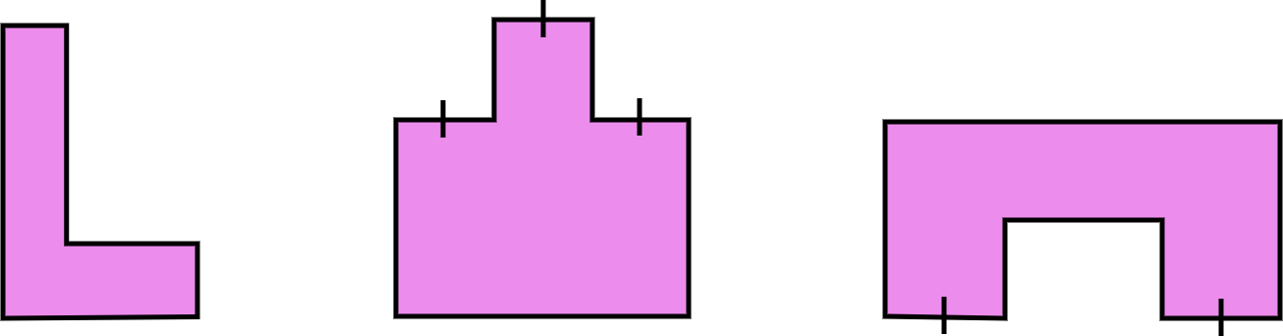
Missing lengths in composite rectilinear shapes
1) Calculate the length of each marked side.
a) b) c)
1
3
n
7
w
m
3.2
1.5
5
z
2.4

Slide 42
Missing lengths in composite rectilinear shapes
1) Calculate the length of each marked side.
a)
1
m = 5 - 1
m = 4
w = 7 - 1.5
w = 5.5
7
w
m
1.5
5

Slide 43
Missing lengths in composite rectilinear shapes
1) Calculate the length of each marked side.
b)
3
z = 3 + 3 + 3
z = 9
z

Slide 44
Missing lengths in composite rectilinear shapes
1) Calculate the length of each marked side.
c)
n
n = 3.2 + 2 x 2.4
n = 8
3.2
2.4

Slide 45
Checking understanding of perimeter and area
Quadrilaterals are a family of polygons that all have four sides.
A shape can belong to more than one family. It can be regular and/or a triangle for example.
The properties of a polygon can be used to calculate the length of unknown sides.

Slide 46

© Oak National Academy 2024.
Produced in partnership with Mathematics in Education and Industry.
Licensed on the Open Government Licence v3.0, except where otherwise stated. See Oak terms and conditions.

